Slide 1
Project title
Submitted in the partial fulfillment for the award of the degree of
BACHELOR OF ENGINEERING
IN
APEX INSTITUTE OF TECHNOLOGY
Submitted by:
20BCS6798 |  | Yash Rana
20BCS6702 |  | Amanjot Singh
20BCS6773 |  | Ayushi Singh
20BCS6771 |  | Anshul Kalia
Under the Supervision of:
Amit Vajpayee (E14118)
Department of AIT-CSE
DISCOVER . LEARN . EMPOWER

Slide 2
Outline
Introduction to Project
Problem Formulation
Objectives of the work
Methodology used
Results and Outputs
Conclusion
Future Scope
References

Slide 3
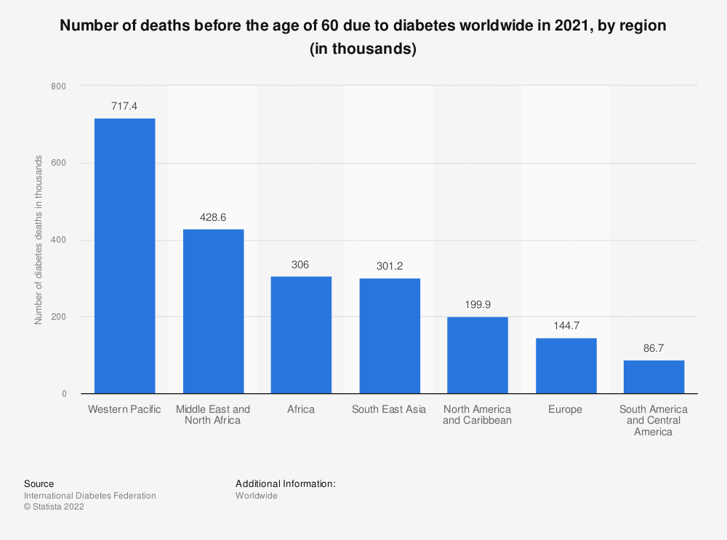
Introduction
Diabetes is a global health epidemic affecting millions worldwide.
High prevalence and associated complications necessitate proactive healthcare strategies.
Early-stage risk prediction emerges as a crucial approach for effective management.
The urgency lies in identifying individuals at risk before complications escalate.
Our research addresses this imperative need through advanced predictive modeling.

Slide 4
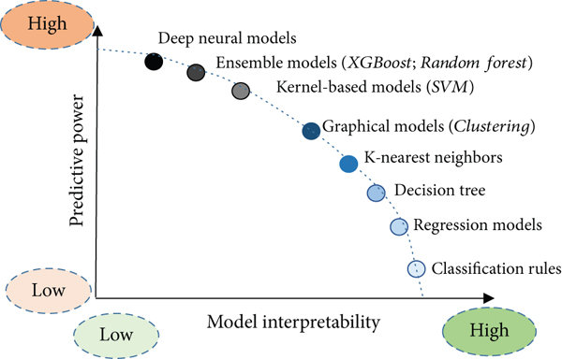
Problem Formulation
Project Objective: Develop a machine learning model to predict diabetes risk based on demographic, clinical, and lifestyle factors.
Data Incorporation: Utilize a comprehensive dataset containing diverse variables such as age, gender, BMI, family history, dietary habits, physical activity levels, and clinical measurements including blood pressure and glucose levels.
Model Development: Employ a range of machine learning algorithms including logistic regression, decision trees, random forests, support vector machines, and neural networks to construct the predictive framework.

Slide 5
Problem Formulation (Contd.)
Performance Evaluation:
Assess model performance using established metrics like accuracy, precision, recall, F1-score, and area under the ROC curve, ensuring reliability and generalization across diverse datasets.
Deployment Strategy:
Implement the trained model in real-world healthcare settings to aid in early detection and intervention strategies for individuals at risk of diabetes.
Interpretability and Insights:
Conduct feature importance analysis and interpretability techniques to uncover underlying factors contributing to diabetes risk, providing actionable insights for preventive healthcare practices.
Impact Assessment:
Evaluate the impact of the model on public health outcomes and preventive healthcare measures, aiming to contribute to improved diabetes management and reduced burden of associated complications.

Slide 6

Objectives of the Work
Comprehensive Literature Review:
Conduct an in-depth review of existing literature on early-stage diabetes risk prediction, assimilating insights from notable studies.
Refinement of Relevant Features:
Identify and refine key features crucial for accurate prediction of early-stage diabetes risk based on literature insights and innovative approaches..
Innovative Methodologies Development:
Explore innovative methodologies for feature selection, data preprocessing, and potential integration of Natural Language Processing (NLP) techniques for improved accuracy and interpretability.
Machine Learning Algorithm Implementation:
Implement and optimize machine learning algorithms, leveraging Python, Scikit-learn, and TensorFlow, with a focus on achieving superior performance based on key evaluation metrics.
Comparative Analysis Against Existing Benchmarks:
Conduct a comparative analysis of the proposed model against existing benchmarks, utilizing industry-standard metrics such as accuracy, sensitivity, and specificity.

Slide 7

Methodologies
Feature Identification and Refinement:
Rigorous identification and refinement of key features crucial for early-stage diabetes risk prediction, drawing inspiration from innovative approaches and literature insights.
Model Development and Optimization:
Systematic development of machine learning models, emphasizing optimization techniques to enhance predictive performance. Python, Scikit-learn, and TensorFlow will be instrumental in this phase.
Potential Integration of NLP Techniques:
Exploration of Natural Language Processing (NLP) techniques, inspired by successful applications in similar domains, for extracting insights from textual data and enhancing predictive capabilities.
Comparative Analysis Framework:
Establishment of a robust framework for the comparative analysis of the proposed model against existing benchmarks, ensuring a comprehensive evaluation using key metrics.

Slide 8
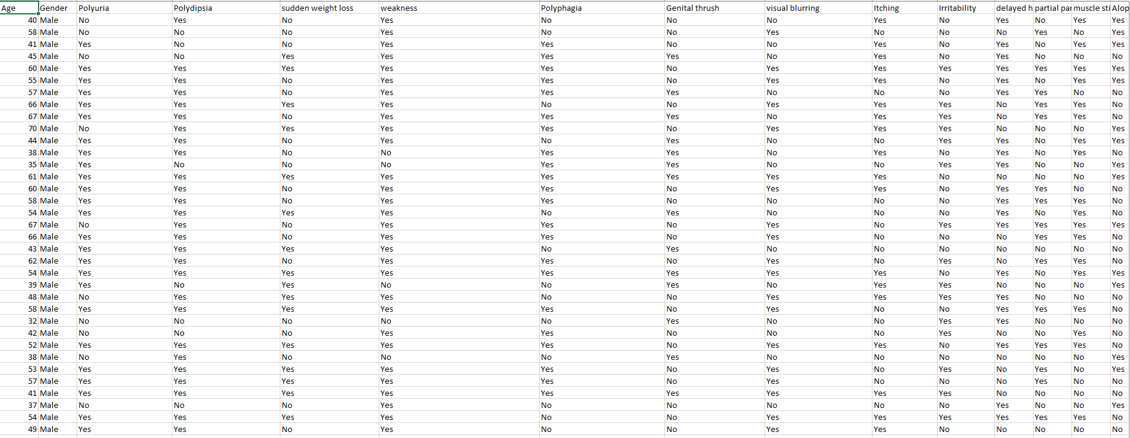
Results and Outputs
Database Selection

Slide 9
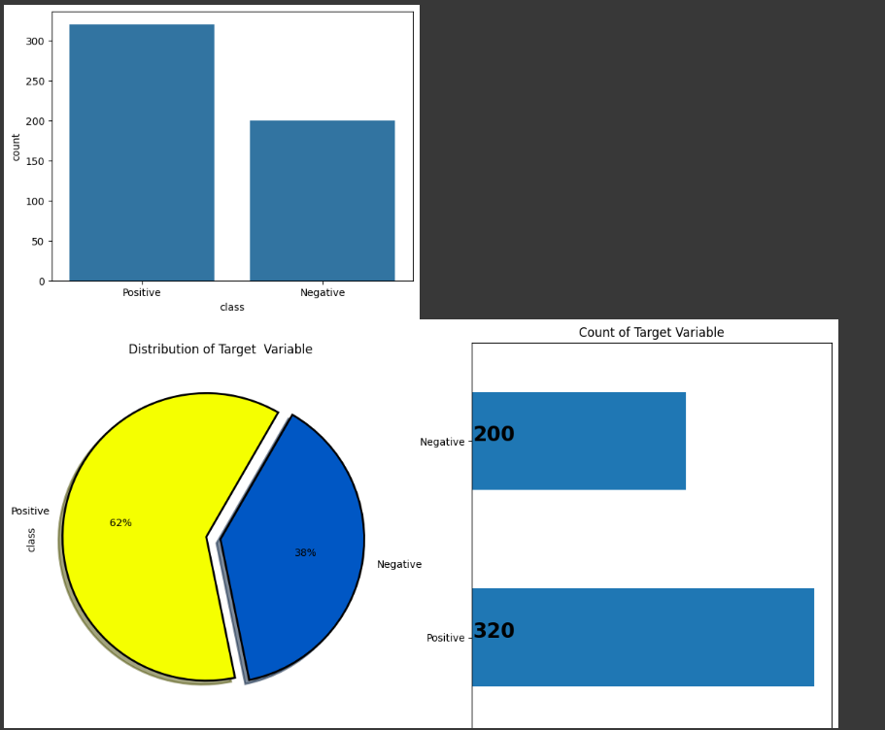
Results and Outputs
Output

Slide 10
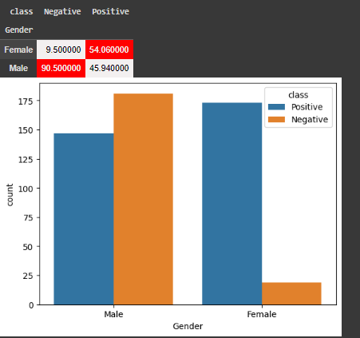
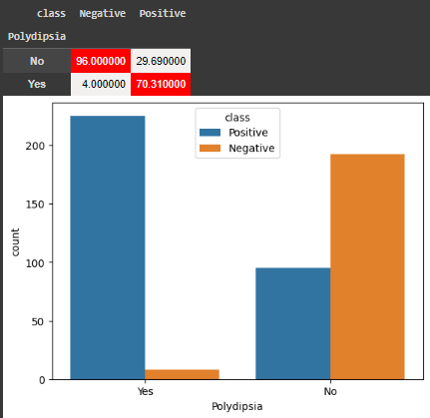
Results and Outputs

Slide 11
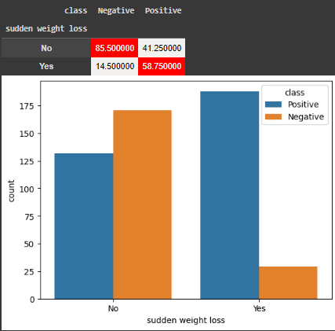
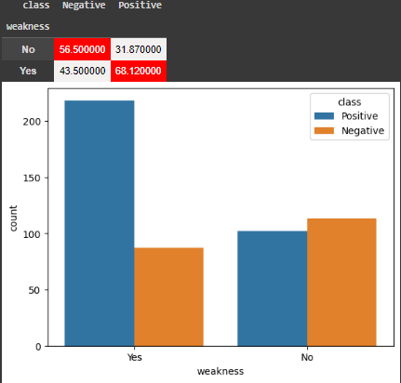
Results and Outputs

Slide 12
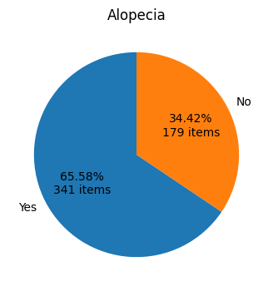
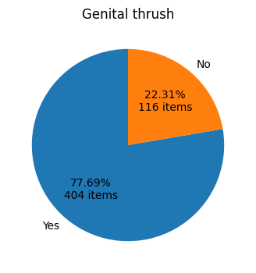
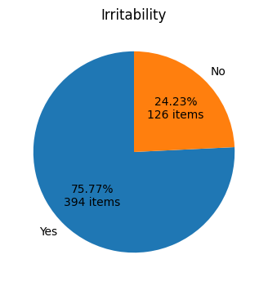
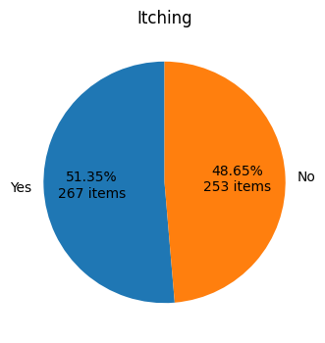
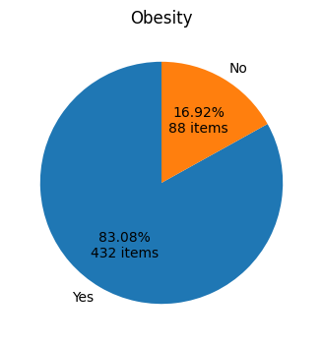
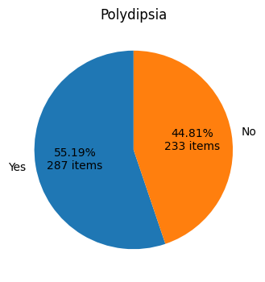
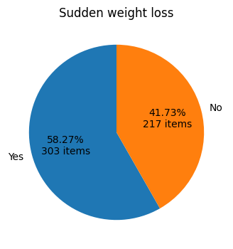
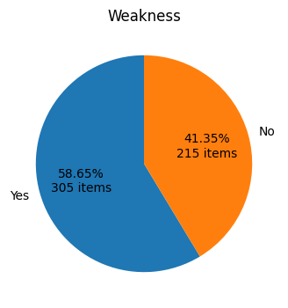
Results and Outputs

Slide 13
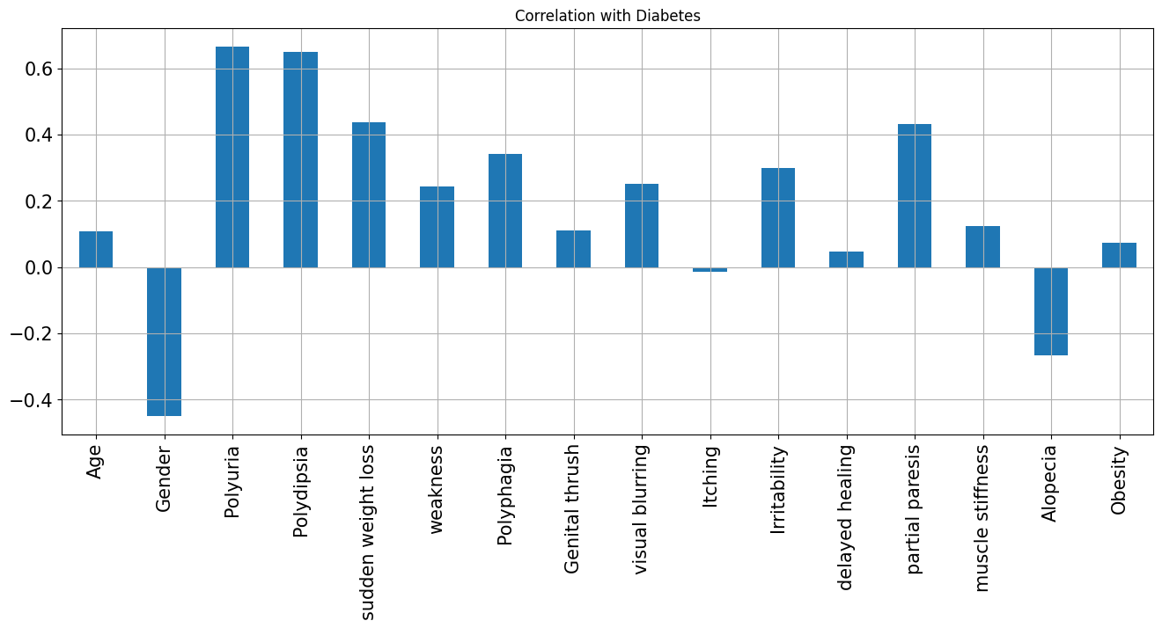
Results and Outputs

Slide 14
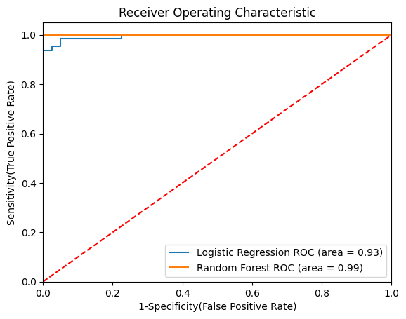
Results and Outputs

Slide 15
Conclusion
In conclusion, while the project endeavors to develop a predictive model for diabetes risk assessment using features like 'Polyuria', 'Polydipsia', 'Age', 'Gender', 'Partial Paresis', 'Sudden Weight Loss', 'Irritability', 'Delayed Healing', 'Alopecia', and 'Itching', several considerations must be taken into account.
The project's database, while containing pertinent features, may suffer from limitations such as a limited feature set, data quality issues, imbalance in data distribution, limited representativeness, lack of temporal dynamics, and ethical and privacy concerns. These drawbacks necessitate cautious handling and thorough analysis to ensure the reliability, fairness, and ethical integrity of the predictive model.Despite these challenges, the project represents a significant step towards leveraging machine learning techniques for proactive diabetes management. By addressing data quality issues, incorporating diverse datasets, and ensuring robust model development methodologies, the project has the potential to contribute valuable insights into diabetes risk assessment and prevention strategies.
Also, it is essential to adopt transparent and interpretable model architectures, adhere to ethical guidelines regarding data privacy and patient confidentiality, and collaborate closely with healthcare professionals to validate and integrate the predictive model into clinical practice effectively.
Ultimately, while the project may face challenges, its potential impact on public health outcomes and preventive healthcare measures underscores the importance of continued research and innovation in diabetes management. With careful consideration of its limitations and proactive measures to mitigate risks, the project can pave the way for improved diabetes risk assessment and personalized intervention strategies, ultimately enhancing the quality of care for individuals at risk of diabetes.

Slide 16
Future Scope
Advanced ML Techniques: Explore deep learning, reinforcement learning, and ensemble methods to enhance predictive accuracy and robustness.
Personalized Risk Assessment: Develop models tailored to individual characteristics, incorporating genetic predispositions and lifestyle habits for precise predictions.
Multi-Modal Data Integration: Utilize electronic health records, wearable devices, genetic databases, and social determinants to enrich risk prediction models.
Real-Time Monitoring Systems: Implement continuous monitoring and feedback systems using wearable sensors and mobile apps for timely interventions.
Longitudinal Studies: Conduct clinical trials and longitudinal studies to validate model efficacy and clinical utility in real-world settings.
Population-Level Interventions: Scale up risk prediction initiatives to community-level interventions for targeted prevention strategies.
Ethical and Regulatory Frameworks: Establish robust ethical and regulatory guidelines to govern data privacy, consent, and algorithm transparency.

Slide 17
References
Ferdousi, Rahatara, M. Anwar Hossain, and Abdulmotaleb El Saddik. "Early-stage risk prediction of non-communicable disease using machine learning in health CPS." IEEE Access 9 (2021): 96823-96837.
Patel, Sanskruti. "Predicting a risk of diabetes at early stage using machine learning approach." Turkish Journal of Computer and Mathematics Education (TURCOMAT) 12, no. 10 (2021): 5277-5284.
Al-Haija, Qasem Abu, Mahmoud Smadi, and Osama M. Al-Bataineh. "Early stage diabetes risk prediction via machine learning." In International Conference on Soft Computing and Pattern Recognition, pp. 451-461. Cham: Springer International Publishing, 2021.
Liang, Jiemei, Jiazhao Song, Tiehui Sun, Lanning Zhang, and Shan Xu. "Development and validation of a nomogram to predict the risk of peripheral artery disease in patients with type 2 diabetes mellitus." Frontiers in Endocrinology 13 (2022): 1059753.
Lu, Lin, Jiayao Zhang, Yi Xie, Fei Gao, Song Xu, Xinghuo Wu, and Zhewei Ye. "Wearable health devices in health care: narrative systematic review." JMIR mHealth and uHealth 8, no. 11 (2020): e18907.
Wee, Boon Feng, Saaveethya Sivakumar, King Hann Lim, W. K. Wong, and Filbert H. Juwono. "Diabetes detection based on machine learning and deep learning approaches." Multimedia Tools and Applications (2023): 1-33.
Malik, Sumbal, Saad Harous, and Hesham El-Sayed. "Comparative analysis of machine learning algorithms for early prediction of diabetes mellitus in women." In International Symposium on Modelling and Implementation of Complex Systems, pp. 95-106. Cham: Springer International Publishing, 2020.

